Slide 1
Kruskal’s Demo
Consider edges in order of increasing weight. Add to MST unless a cycle is created.
Repeat until V-1 edges.
0-2 1
2-4 1
3-6 1
5-6 1
0-1 2
4-1 3
3-4 3
6-4 3
4-5 4
1-2 5
1-3 11
2-5 15
3
11
1
1
3
2
3
6
5
4
3
s
0
1
1
4
1
2
15
5
MST: []

Slide 2
Kruskal’s Demo
Consider edges in order of increasing weight. Add to MST unless a cycle is created.
Repeat until V-1 edges.
0-2 1
2-4 1
3-6 1
5-6 1
0-1 2
4-1 3
3-4 3
6-4 3
4-5 4
1-2 5
1-3 11
2-5 15
3
11
1
1
3
2
3
6
5
4
3
s
0
1
1
4
1
Cycle?
2
15
5
White and green colorings for vertices show cut being implicitly utilized by Kruskal’s algorithm.
MST: []

Slide 3
Kruskal’s Demo
Consider edges in order of increasing weight. Add to MST unless a cycle is created.
Repeat until V-1 edges.
0-2 1
2-4 1
3-6 1
5-6 1
0-1 2
4-1 3
3-4 3
6-4 3
4-5 4
1-2 5
1-3 11
2-5 15
3
11
1
1
3
2
3
6
5
4
3
s
0
1
1
4
1
Cycle? No.
2
15
5
MST: [0-2]

Slide 4
Kruskal’s Demo
Consider edges in order of increasing weight. Add to MST unless a cycle is created.
Repeat until V-1 edges.
0-2 1
2-4 1
3-6 1
5-6 1
0-1 2
4-1 3
3-4 3
6-4 3
4-5 4
1-2 5
1-3 11
2-5 15
3
11
1
1
3
2
3
6
5
4
3
s
0
1
1
4
1
Cycle? No.
2
15
5
White and green colorings for vertices show cut being implicitly utilized by Kruskal’s algorithm.
MST: [0-2]

Slide 5
Kruskal’s Demo
Consider edges in order of increasing weight. Add to MST unless a cycle is created.
Repeat until V-1 edges.
0-2 1
2-4 1
3-6 1
5-6 1
0-1 2
4-1 3
3-4 3
6-4 3
4-5 4
1-2 5
1-3 11
2-5 15
3
11
1
1
3
2
3
6
5
4
3
s
0
1
1
4
1
Cycle? No.
2
15
5
MST: [0-2, 2-4]

Slide 6
Kruskal’s Demo
Consider edges in order of increasing weight. Add to MST unless a cycle is created.
Repeat until V-1 edges.
0-2 1
2-4 1
3-6 1
5-6 1
0-1 2
4-1 3
3-4 3
6-4 3
4-5 4
1-2 5
1-3 11
2-5 15
3
11
1
1
3
2
3
6
5
4
3
s
0
1
1
4
1
Cycle?
2
15
5
White and green colorings for vertices show cut being implicitly utilized by Kruskal’s algorithm.
MST: [0-2, 2-4]

Slide 7
Kruskal’s Demo
Consider edges in order of increasing weight. Add to MST unless a cycle is created.
Repeat until V-1 edges.
0-2 1
2-4 1
3-6 1
5-6 1
0-1 2
4-1 3
3-4 3
6-4 3
4-5 4
1-2 5
1-3 11
2-5 15
3
11
1
1
3
2
3
6
5
4
3
s
0
1
1
4
1
Cycle? No.
2
15
5
MST: [0-2, 2-4, 3-6]

Slide 8
Kruskal’s Demo
Consider edges in order of increasing weight. Add to MST unless a cycle is created.
Repeat until V-1 edges.
0-2 1
2-4 1
3-6 1
5-6 1
0-1 2
4-1 3
3-4 3
6-4 3
4-5 4
1-2 5
1-3 11
2-5 15
3
11
1
1
3
2
3
6
5
4
3
s
0
1
1
4
1
Cycle?
2
15
5
White and green colorings for vertices show cut being implicitly utilized by Kruskal’s algorithm.
MST: [0-2, 2-4, 3-6]

Slide 9
Kruskal’s Demo
Consider edges in order of increasing weight. Add to MST unless a cycle is created.
Repeat until V-1 edges.
0-2 1
2-4 1
3-6 1
5-6 1
0-1 2
4-1 3
3-4 3
6-4 3
4-5 4
1-2 5
1-3 11
2-5 15
3
11
1
1
3
2
3
6
5
4
3
s
0
1
1
4
1
Cycle? No.
2
15
5
MST: [0-2, 2-4, 3-6, 5-6]

Slide 10
Kruskal’s Demo
Consider edges in order of increasing weight. Add to MST unless a cycle is created.
Repeat until V-1 edges.
0-2 1
2-4 1
3-6 1
5-6 1
0-1 2
4-1 3
3-4 3
6-4 3
4-5 4
1-2 5
1-3 11
2-5 15
3
11
1
1
3
2
3
6
5
4
3
s
0
1
1
4
1
Cycle?
2
15
5
White and green colorings for vertices show cut being implicitly utilized by Kruskal’s algorithm.
MST: [0-2, 2-4, 3-6, 5-6]

Slide 11
Kruskal’s Demo
Consider edges in order of increasing weight. Add to MST unless a cycle is created.
Repeat until V-1 edges.
0-2 1
2-4 1
3-6 1
5-6 1
0-1 2
4-1 3
3-4 3
6-4 3
4-5 4
1-2 5
1-3 11
2-5 15
3
11
1
1
3
2
3
6
5
4
3
s
0
1
1
4
1
Cycle? No.
2
15
5
MST: [0-2, 2-4, 3-6, 5-6, 0-1]

Slide 12
Kruskal’s Demo
Consider edges in order of increasing weight. Add to MST unless a cycle is created.
Repeat until V-1 edges.
0-2 1
2-4 1
3-6 1
5-6 1
0-1 2
4-1 3
3-4 3
6-4 3
4-5 4
1-2 5
1-3 11
2-5 15
3
11
1
1
3
2
3
6
5
4
3
s
0
1
1
4
1
Cycle?
2
15
5
White and green colorings for vertices show cut being implicitly utilized by Kruskal’s algorithm.
MST: [0-2, 2-4, 3-6, 5-6, 0-1]

Slide 13
Kruskal’s Demo
Consider edges in order of increasing weight. Add to MST unless a cycle is created.
Repeat until V-1 edges.
0-2 1
2-4 1
3-6 1
5-6 1
0-1 2
4-1 3
3-4 3
6-4 3
4-5 4
1-2 5
1-3 11
2-5 15
3
11
1
1
3
2
3
6
5
4
3
s
0
1
1
4
1
Cycle? Yes. Reject!
2
15
5
MST: [0-2, 2-4, 3-6, 5-6, 0-1]

Slide 14
Kruskal’s Demo
Consider edges in order of increasing weight. Add to MST unless a cycle is created.
Repeat until V-1 edges.
0-2 1
2-4 1
3-6 1
5-6 1
0-1 2
4-1 3
3-4 3
6-4 3
4-5 4
1-2 5
1-3 11
2-5 15
3
11
1
1
3
2
3
6
5
4
3
s
0
1
1
4
1
Cycle?
2
15
5
White and green colorings for vertices show cut being implicitly utilized by Kruskal’s algorithm.
MST: [0-2, 2-4, 3-6, 5-6, 0-1]

Slide 15
Kruskal’s Demo
Consider edges in order of increasing weight. Add to MST unless a cycle is created.
Repeat until V-1 edges.
0-2 1
2-4 1
3-6 1
5-6 1
0-1 2
4-1 3
3-4 3
6-4 3
4-5 4
1-2 5
1-3 11
2-5 15
3
11
1
1
3
2
3
6
5
4
3
s
0
1
1
4
1
V-1 edges, so we’re done!
2
15
5
MST: [0-2, 2-4, 3-6, 5-6, 0-1, 3-4]

Slide 16
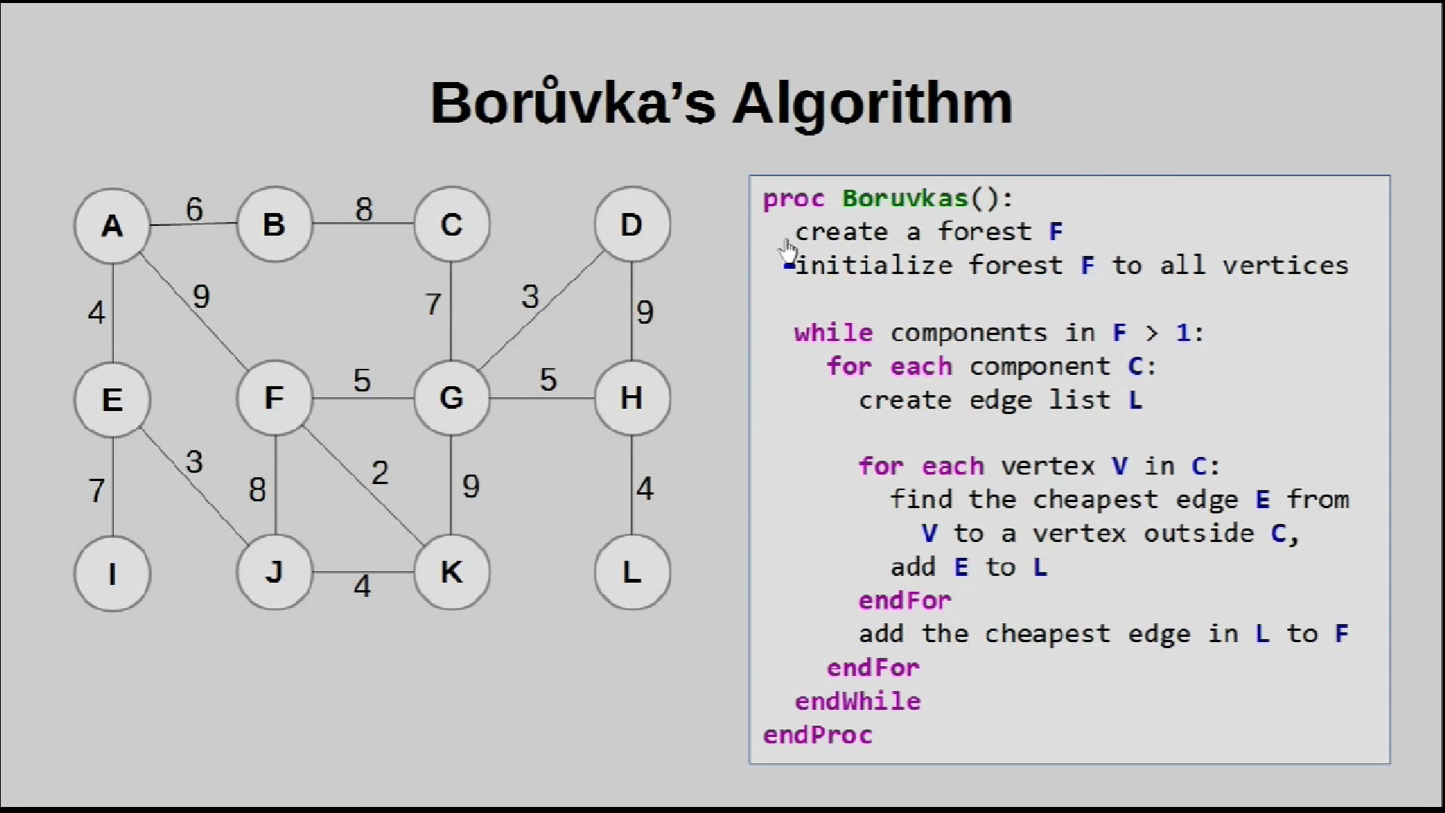

Slide 17
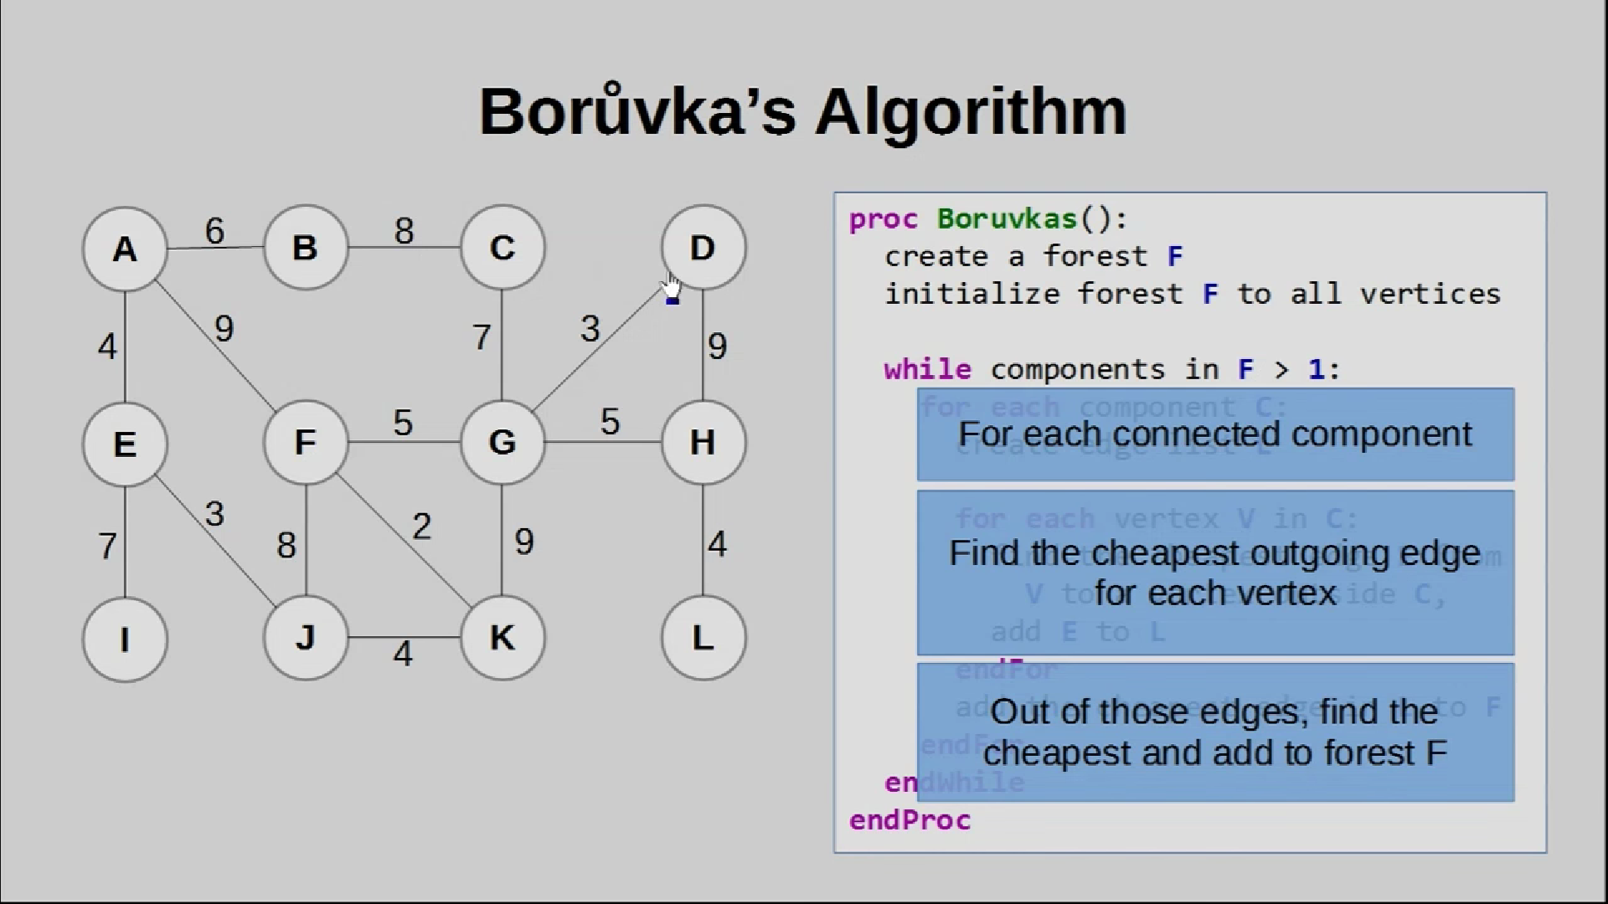

Slide 18
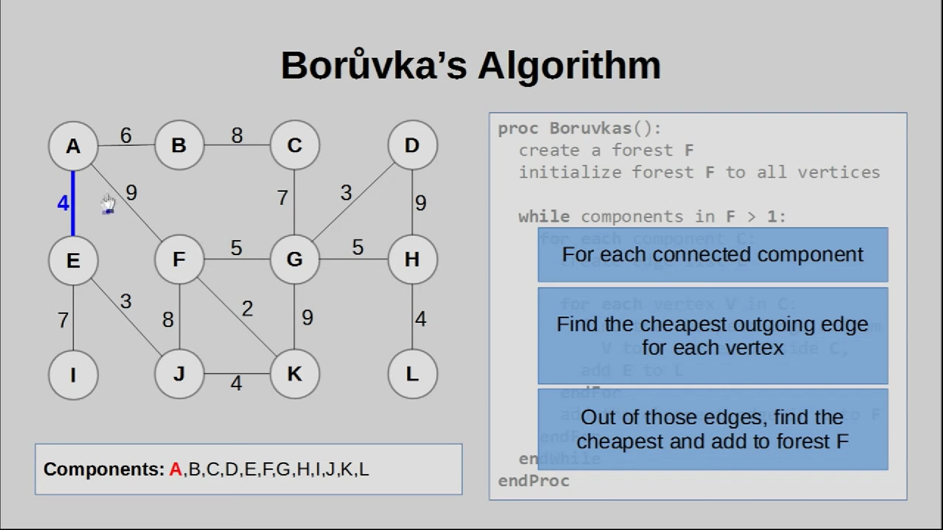

Slide 19
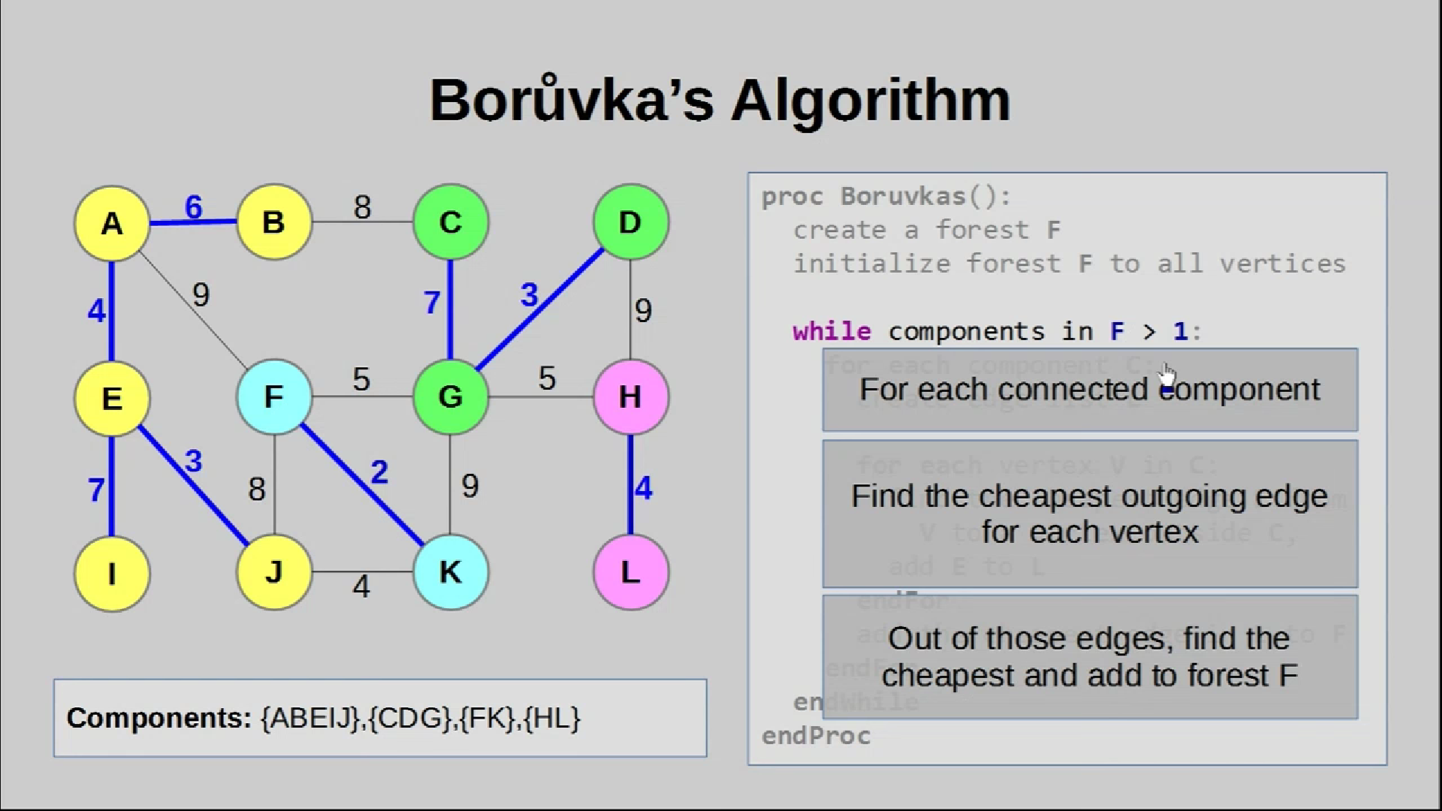

Slide 20
